Slide 1
New topic: modeling sequences
Lots of interesting things in the world can be thought of as sequences
Ordering of heads/tails in multiple coin flips
Ordering of moves in rock/paper/scissors
Text
Music
Closing stock prices
Web pages you visit on Wikipedia
1

Slide 2
How are sequences generated?
For some sequences, each element is generated independently
  Coin flips
For others, the next element is generated deterministically
  1, 2, 3, 4, 5, … ?
For others, the next element depends on previous elements, but exhibits some randomness
  The sequence of web pages you visit on Wikipedia
  We’ll focus on these (many interesting sequences can be modeled this way)

Slide 3
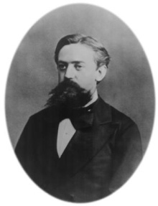







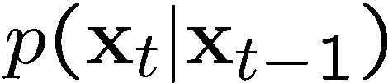

Markov chains
A sequence of discrete random variables
  is the state of the model at time t
  Markov assumption: each state is dependent only on the previous one
    dependency given by a conditional probability:
  This is actually a first-order Markov chain
  An N’th-order Markov chain:
Andrei Markov
(Slide credit: Steve Seitz)

Slide 4



Markov chains
Example: Springtime in Ithaca
Three possible conditions: nice, rainy, snowy
If it’s nice today, then tomorrow it will be:
rainy 75% of the time
snowy 25% of the time
If it’s rainy today, then tomorrow it will be:
rainy 25% of the time
nice 25% of the time
snowy 50% of the time
If it’s snowy today, then tomorrow it will be:
rainy 50% of the time
nice 25% of the time
snowy 25% of the time

Slide 5

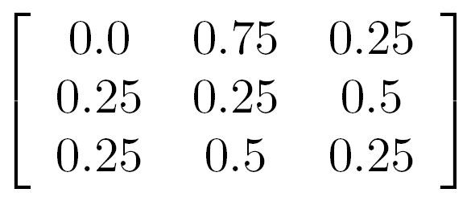

Markov chains
Example: Springtime in Ithaca
We can represent this as a kind of graph
(N = Nice, S = Snowy, R = Rainy)
0.75
0.25
N
R
N
R
S
0.25
N
0.25
0.5
0.5
R
0.25
S
S
Transition probabilities
0.25

Slide 6


Markov chains
Example: Springtime in Ithaca
We can represent this as a kind of graph
(N = Nice, S = Snowy, R = Rainy)
If it’s nice today, what’s the probability that it will be nice tomorrow?
N
R
S
N
R
S
If it’s nice today, what’s the probability that it will be nice the day after tomorrow?
Transition probabilities

Slide 7


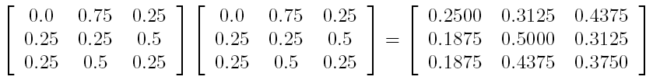

Markov chains
N
R
S
The transition matrix at time t+2 is
The transition matrix at time t+n is
N
=
R
S

Slide 8
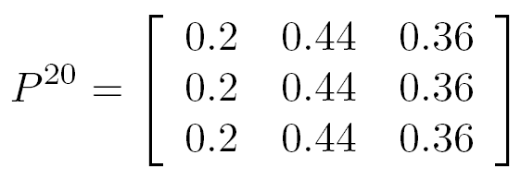
Markov chains
What’s will the weather be like in 20 days?
Almost completely independent of the weather today
The row [0.2 0.44 0.36] is called the stationary distribution of the Markov chain

Slide 9
Markov chains
Where do we get the transition matrix from?
One answer: we can learn it from lots of data (e.g., 20 years of weather data)

Slide 10
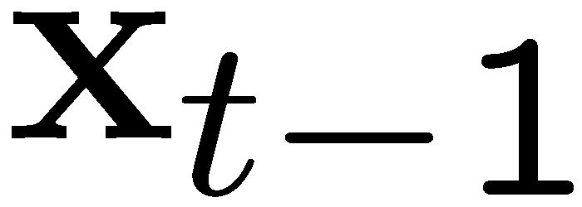
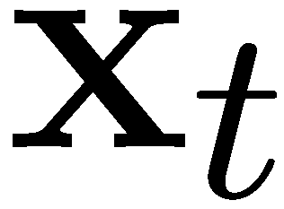
Markov Chain Example: Text
“A dog is a man’s best friend. It’s a dog eat dog world out there.”
a
 | 2/3 |  | 1/3
 |  | 1/3 |  |  |  |  | 1/3 | 1/3
1
 |  |  |  | 1
 |  |  |  |  | 1
 |  |  |  |  |  |  |  |  |  |  | 1
1
 | 1
 |  |  |  |  |  |  |  |  | 1
 |  |  |  |  |  |  |  |  |  | 1
 |  |  |  |  |  |  |  |  |  |  | 1
 |  |  |  |  |  | 1
dog
is
man’s
best
friend
it’s
eat
world
out
there
.
a
dog
is
it’s
eat
out
.
best
friend
there
man’s
world
(Slide credit: Steve Seitz)

Slide 11
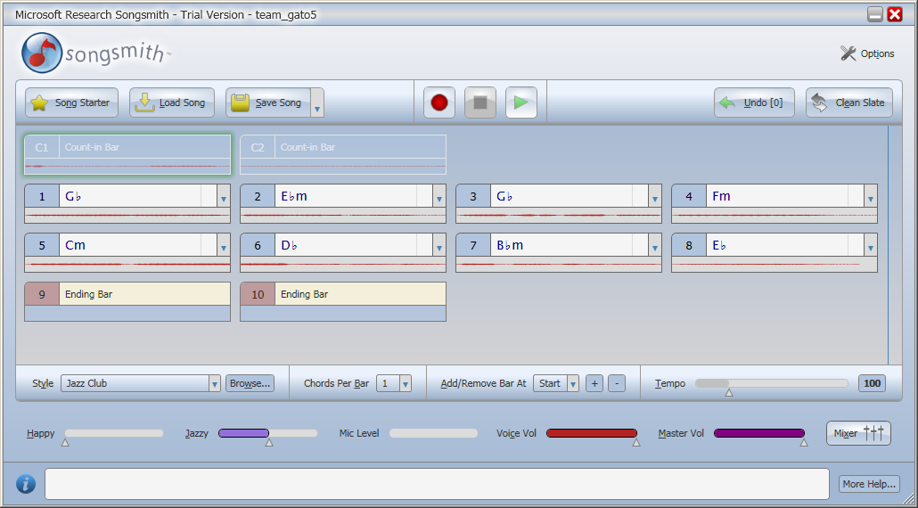
Music synthesis
C
0.6
0.7
0.1
0.4
Am
G
0.2
0.6
0.1
0.3
0.4
F
0.6
Chord progressions learned from large database of guitar tablature

Slide 12
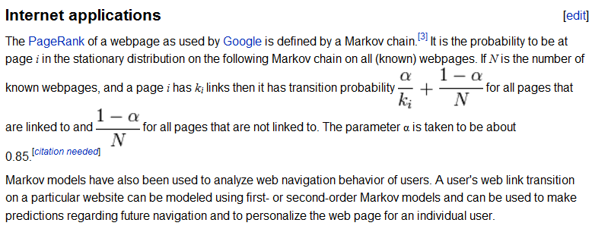
Google’s PageRank
http://en.wikipedia.org/wiki/Markov_chain
Page, Lawrence; Brin, Sergey; Motwani, Rajeev and Winograd, Terry (1999).
The PageRank citation ranking: Bringing order to the Web.
See also:
J. Kleinberg. Authoritative sources in a hyperlinked environment. Proc. 9th ACM-SIAM Symposium on Discrete Algorithms, 1998.

Slide 13
Google’s PageRank
H
Graph of the Internet (pages and links)
A
I
D
E
B
C
F
J
G

Slide 14
Google’s PageRank
H
Start at a random page, take a random walk. Where do we end up?
A
I
D
E
B
C
F
J
G

Slide 15
Google’s PageRank
H
Add 15% probability of moving to a random page. Now where do we end up?
A
I
D
E
B
C
F
J
G

Slide 16
Google’s PageRank
H
PageRank(P) = Probability that a long random walk ends at node P
A
I
D
E
B
C
F
J
G

Slide 17
